Slide 1

JAMM MOTORS
PROJECT SPYN
Jake Andrus
Anirudh Chinepalli
Michael Galvan
Mohit Doshi

Slide 2
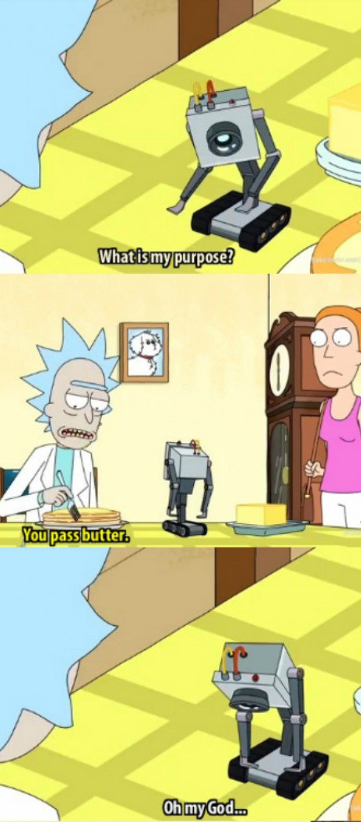


Project Spyn and our customer(s)
Autonomous car that keeps safety in mind
Ride-sharing concept
Main market: Senior citizens
Disabled and Wheelchair friendly
Targeting large retirement communities
Notes:
Perfect blend of safety and speed
Safety over speed
Why autonomous? Because machines are physical representations of a human's idea; humans make mistakes, machines don’t.
Autonomous, not sentient

Slide 3
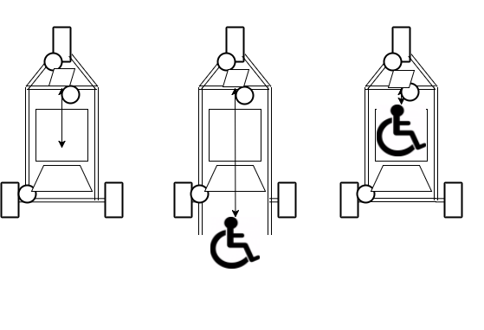
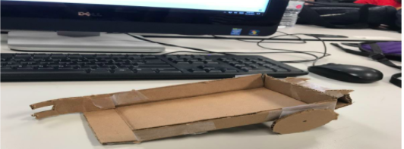
Initial Designs
2 Wheels
Gate-Claw hybrid
300hp
Truck bed/ramp transport area
Autonomous chauffeur
Grappling Hook + Ramp
Notes:
Final design based on the initial prototype
Everybody came up with different ideas, all the flaws were removed, and the final design was a mixture of everyone's ideas.

Slide 4
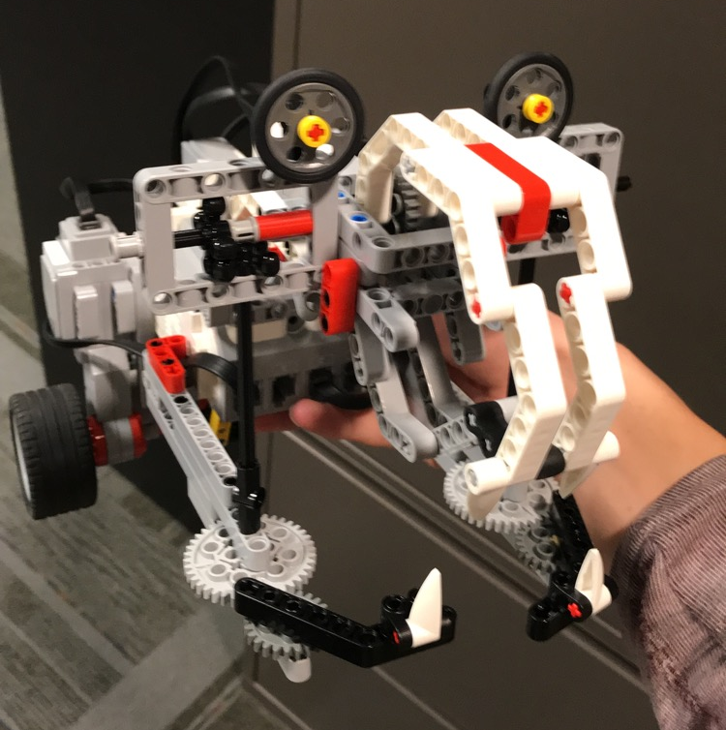
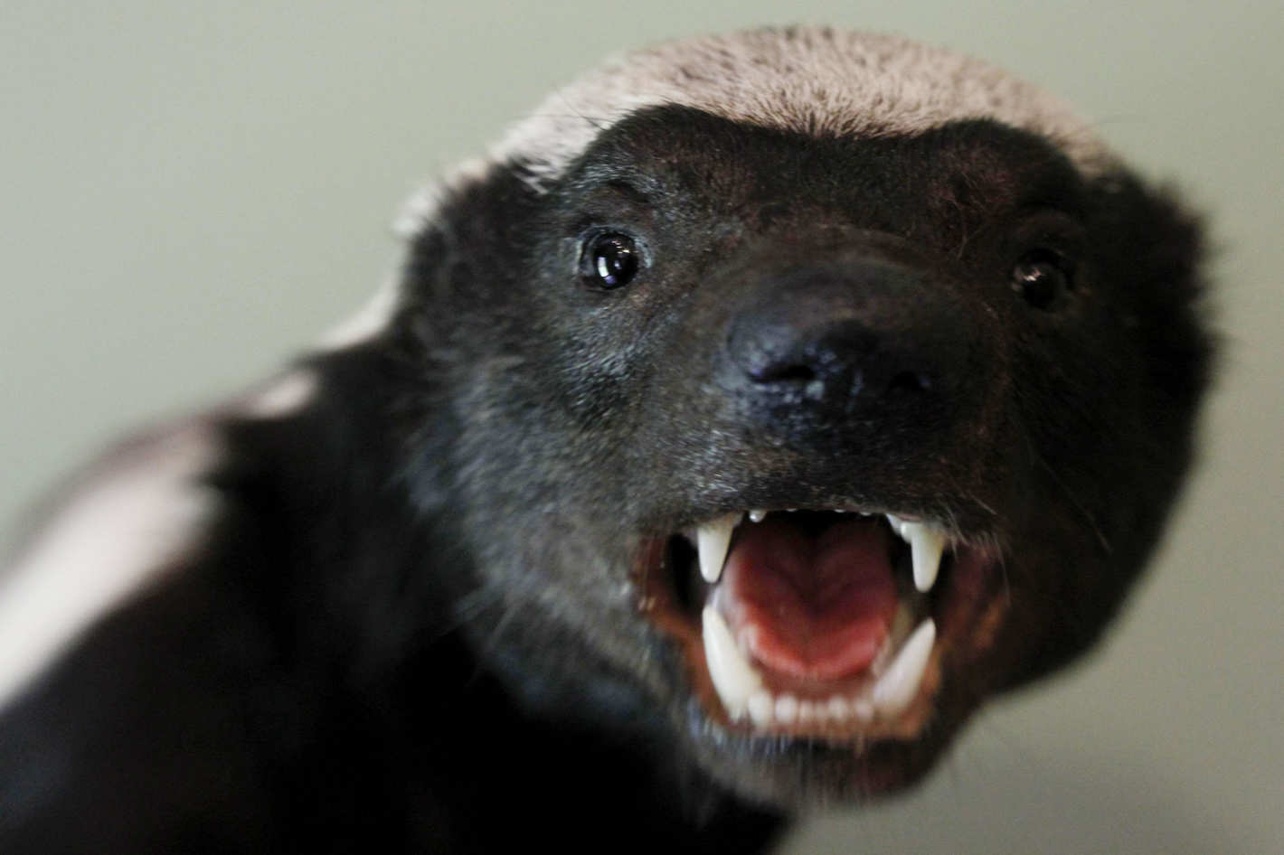
The HoneyBadger
®️
Named after its jaw-like apparatus and soul-piercing eyes
3 closing sections + seatbelt working off one motor provides security and efficiency
Teeth act as locking mechanism
Eyes provide intimidation and therefore cooperation in transport victims customers
Starboard proximity sensor, port and bow touch sensors, bow color sensor
Transport area in stern
Two anterior wheels, controlled by independent motors, allow for zero-point turning
Notes:
Speak about “why two wheels”
Mention the revisions to the claw, vehicle specifications

Slide 5
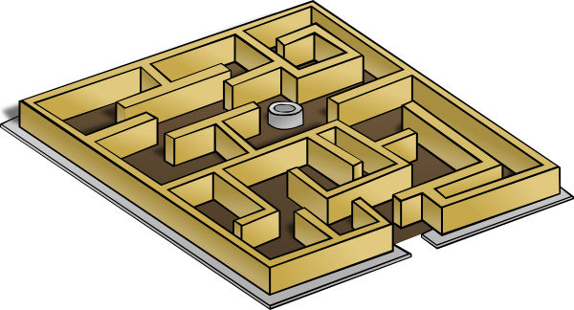
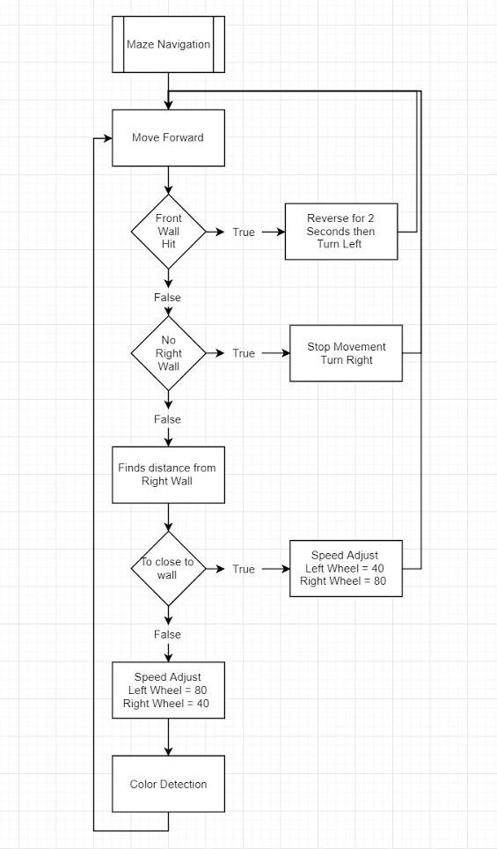
MAZE Navigation
Uses the wall follower Maze Algorithm
Movement
Constant forward movement.
Independent wheel speed.
Speeds are adjusted based off of the proximity to right wall.
Turning
Moves forward then turns approximately 90 degrees right when no right wall is detected.
Reverse and left turn on encountering a front wall.
Notes:
Car constantly keeps on the right side of the maze eventually it will drive through the entire maze.
Car handles turning through the use of the sensors
Uses the touch sensor to detect front walls
Once hit the car reverses then turns 90 degrees left
Uses the ultrasonic sensor to detect when there isn’t a right wall
Once no close right wall is detect for a time the car stops and turns 90 degrees right
If No condition is met to turn car continues to go forward

Slide 6




Passenger Transportation
The vehicle is designed to carry one passenger, who is seated in the posterior portion of the vehicle
The vehicle switches to remote control when the pick-up zone is encountered
It makes a 180˚ turn, approaches the passenger and secures him/her with the seatbelt, claws, and gate-claws.
The vehicle switches to autonomous mode, and navigates to the dropoff point, acknowledging stop-points en route
The vehicle switches to remote control when the drop-off zone is encountered. It makes a 180˚ turn. The claws, seatbelt unlock and the passenger is dropped off as the vehicle backs up.
Notes:
Car structurally sound to absorb impact without throwing about the passenger, also most of the impacts are happening in the anterior portion and the passenger won’t feel any of them
180˚ turn, quick and simple
Acknowledges all stop points en route by halting momentarily and subsequently resuming motion
Remote control via a bluetooth controlled device

Slide 7


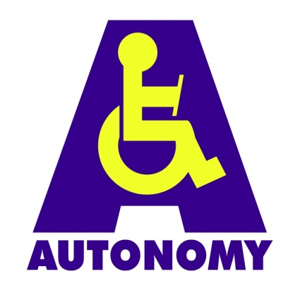
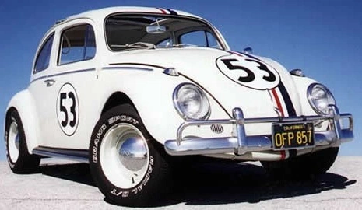
Future Plans
Fully autonomous navigation, pick-up, and drop-off
Scanning the maze and logging turns, speed modifications, stop, pick-up, drop-off points
Increasing seating capacity to accommodate a companion, service animal

Slide 8
References
https://education.lego.com/en-us/products/lego-mindstorms-education-ev3-core-set-/5003400Senix.
https://senix.com/distance-ranging/Wikipedia
https://en.wikipedia.org/wiki/Maze_solving_algorithm
honeybadger.com

